Slide 1
How To Prepare and Present A Poster
Website: http://www.umich.edu/~ursymposium/index.html
Email: URS-Committee@umich.edu

Slide 2
Why a poster to communicate your research?
Concise summary of your work
A more personable approach to presenting
Good for networking
Good for “elevator pitches”
Used by undergraduates, graduate students, and postdocs. Even faculty members make posters that summarize the work of their labs

Slide 3
Judging
Graduate student and postdoctoral judges from a variety of disciplines will be evaluating your work
Three main criteria:
Research Innovation
Impact/context
Research Overview
“Big Picture”
Research Communication
Explanation & Accessibility
$500 travel awards will be given to highest scoring presenters to present at an external conference

Slide 4
Poster Prep: General Notes
Everyone will have the same general structure (i.e. intro, methods, results, etc.) but 2 key things will be different:
Your content
How you walk someone through your poster. This is done by:
Organizing and illustrating of your content via
Concise & effective use of text
Pictures,graphs, or charts for ease of interpretation
Talking about your work and walking through it live
Above all, PRACTICE MAKES PERFECT

Slide 5
Poster Prep: Powerpoint
Go to design, slide/slide size
Suggested proportions are 4:3 and dimensions of anything below 48x40 (will have to scale)
Can start with a template (on our website) or make your own

Slide 6
Poster Prep: URS Template

Slide 7
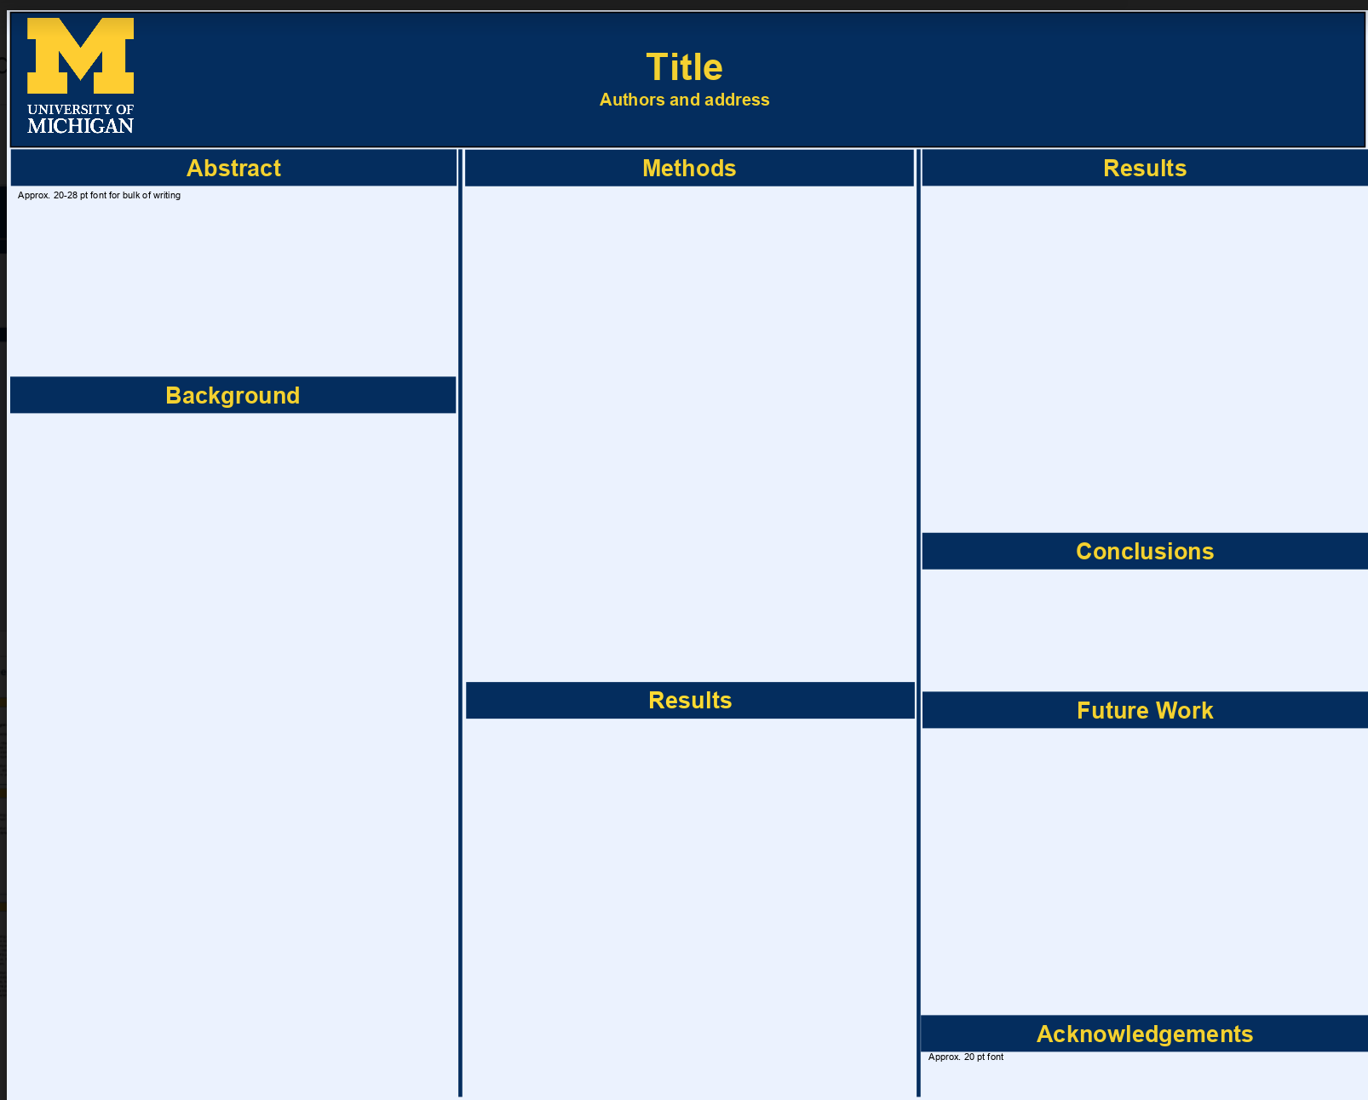
Poster Prep: URS Template

Slide 9
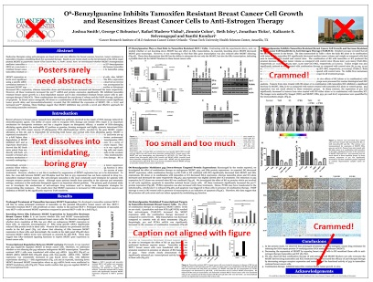
Notes:
IMAGES MAKE ALL THE DIFFERENCE!!!
You want your audience to look at your poster and want to know more/ be interested. Images (in color) often help with that. You do not want them to have to read a lot of text

Slide 10
Poster Prep: Sections
Motivation/Background/Abstract
Give a general overview of what you’re going to talk about
Should have figures/schematics and text bullets only if necessary
Research objectives
Bullet points and schematics
Materials and Methods
Explain what you did and why you did it
Concise incomplete sentences
You want someone to understand enough of the poster when you’re not there but need further explanation from you
Results and Analysis
Same as points b and c above
Conclusions and Future Work
References
Acknowledgments
Notes:
Acknowledgements are important to remember as they show where the funding for this research came from!

Slide 11
Elevator Pitch
Practice makes perfect!
Tailor your talk:
How familiar are you with [insert topic: driverless cars, AI, self-efficacy, genetic engineering, etc...]? This will help you tailor your talk
Be ready for experts in your field and people who have never heard of your field
Have a 2-3 min version of your talk focusing on why your work is important in lay terms and then ask if they want to learn more
Focus on:
What you did
Why you did it
Why it is important
Notes:
Could run through a poster for practice. Could have them either run through their own posters or you could print out two of the same posters and have them each take a turn practicing with partners after having a few minutes to read through it. (use my psych and a sciencey one)

Slide 12
Presentation
IF THEY WANT TO LEARN MORE
Then go in depth about why your field is important
Why the questions you’re asking in your field are important?
How are you asking them (Methods & Materials)?
What are your results?
What do they mean for your questions and for your field?
Any future work and points of further investigation
Talk about what you are going to do/what your goals are, where this research will lead you in the future, how it has guided your future plans,etc.
THEY SMILE UNCOMFORTABLY???
You’ve done great, shared your research, and now you smile and thank them for stopping by.

Slide 13
General Notes:
Smile: Present yourself & your research in a positive light
Take a deep breath: this is a low pressure opportunity to gain experience
Be prepared:
Practice practice practice
Think of questions people might ask and be prepared to answer
Know the landscape of your poster
Point out figures, walk them through graphs & images.
Ask us if you have any questions: the committee will be there to help!
Notes:
If you’re excited about your research, someone else will be too
“The beauty of humanity is that if you find something interesting, odds are someone else will also” Dave MacMillan (paraphrased)

Slide 14
Takeaway Message
Your poster should include these key components
Motivation/Background/Abstract
Research objectives
Materials and Methods
Results and Analysis
Conclusions and Future Work
References
Acknowledgments

Slide 15
Poster Sketch Activity
Using the template provided, sketch out your poster.
Motivation/Background/Abstract
Research objectives
Materials and Methods
Results and Analysis
Conclusions and Future Work
References
Acknowledgments

Slide 16
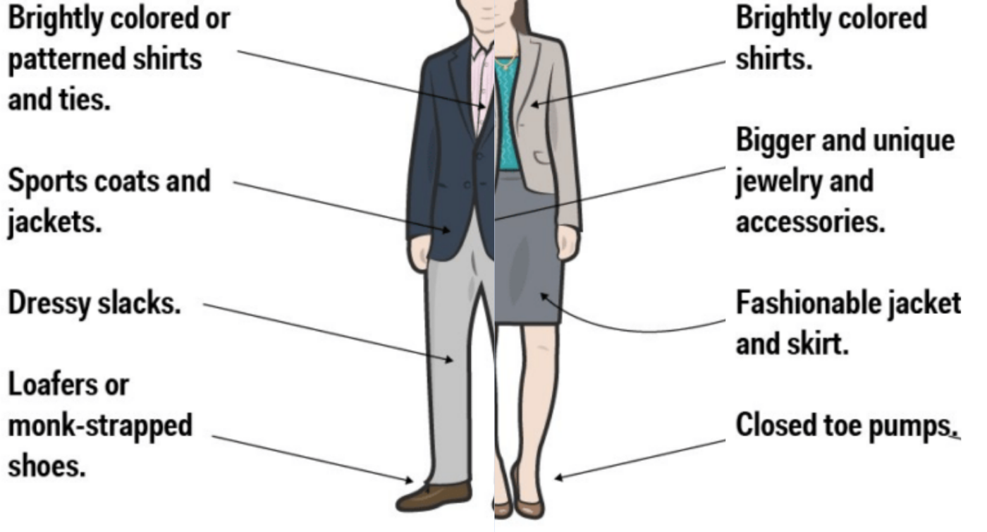
What is Business Casual?

Slide 17
What Does that Mean?

Slide 18
THANK YOU!
ANY QUESTIONS?

